Slide 1
DRUG PREDICTION
USING NATURAL LANGUAGE PROCESSING
P-459
GROUP-1

Slide 2
TEAM MEMBERS
Saravanan Rishitha
Panidapu Hima Chandana
Lehimsha Shaik
Navuru Sai Saaketh
Deepa B

Slide 3

Problem Statement
Visualization
Model Building
Project Architecture
Text Pre-Processing
Deployment
Introduction
Data set Details
Challenges

Slide 4
PROBLEM STATEMENT
To analyze the dataset for extracting insights into user sentiment, reviews and conditions treated.
This involves cleaning, preprocessing, and building predictive models to classify conditions based on reviews.
To understand user sentiment and satisfaction through drug reviews.
To identify patterns in drug efficacy and the conditions they are used for.
To build predictive models to classify conditions or predict ratings using textual data.

Slide 5
2. PROJECT ARCHITECTURE
Import data file
Data Pre-processing: Missing values, unique values, descriptive statistics
Text Pre-processing: Tokenization, Removing Stop Words, Removing Punctuations, Stemming, TF-IDF
Visualization: Bigrams, Trigrams, N-Grams, Word Cloud
Data Imbalance: SMOTE TECHNIQUE
Standardization and PCA
Data Partition
Model Building
Evaluation Metrics
Deployment

Slide 6
3. INTRODUCTION
The primary aim of this project is to analyze patient reviews of drugs to extract meaningful insights about their sentiment and the conditions treated.
The goal is to use natural language processing (NLP) techniques and machine learning to understand how patients perceive medications, identify key trends, and develop predictive models for drug classification or rating prediction.

Slide 7
Introduction to the Dataset
The dataset offers a unique opportunity to study the intersection of healthcare and NLP.
It includes user-generated reviews and ratings of drugs for specific conditions.
This helps in analyzing:
Drug effectiveness based on user feedback.
Sentiment trends in user reviews.
Popular drugs for specific conditions.

Slide 8
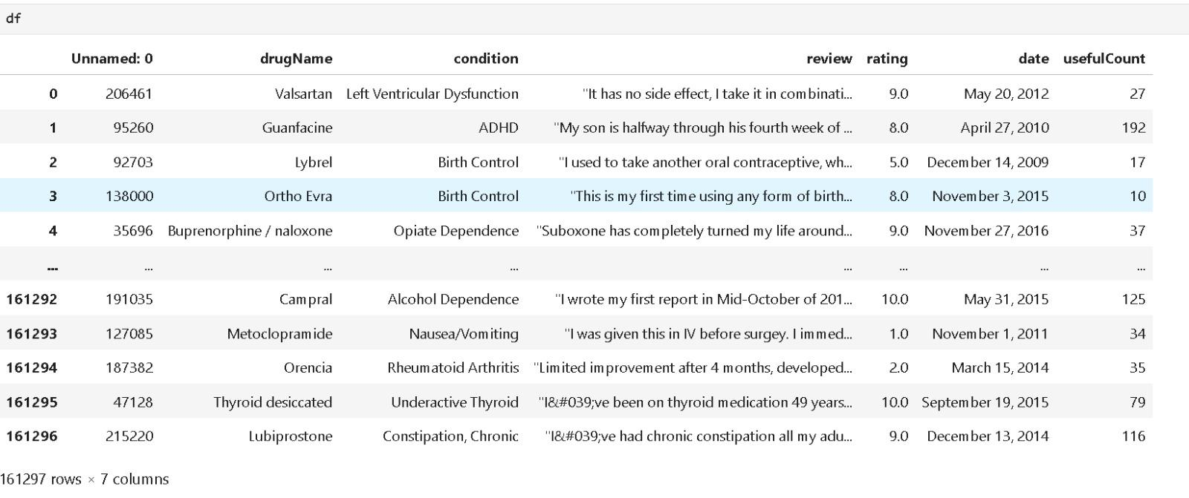
DATA SET DETAILS

Slide 9
5. TEXT PRE-PROCESSING
Tokenization: Break reviews into individual words.
Stopword Removal: Remove common words like "the", "and", etc., which don’t add meaning.
Stemming & Lemmatization: Normalize words to their root forms.
TF-IDF Transformation: Convert reviews into numerical features while emphasizing unique words.

Slide 10
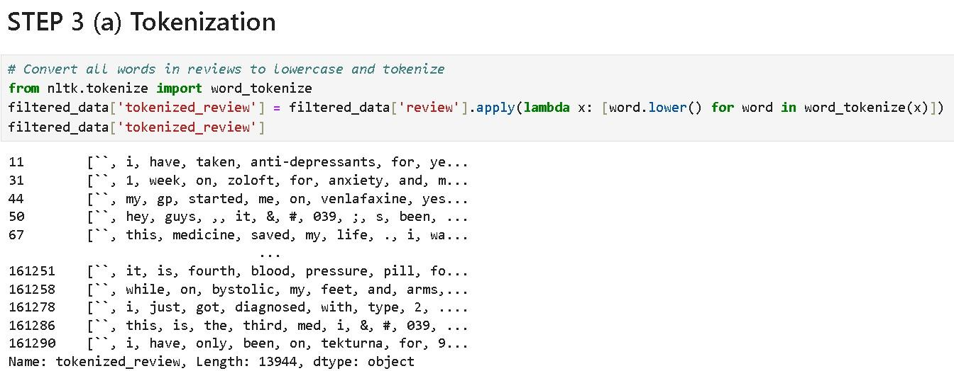

Slide 11
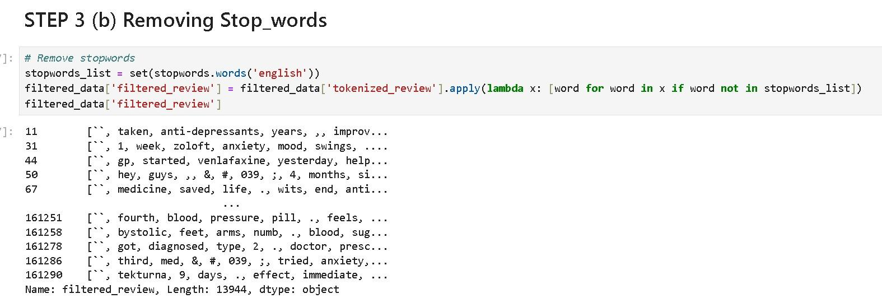

Slide 12

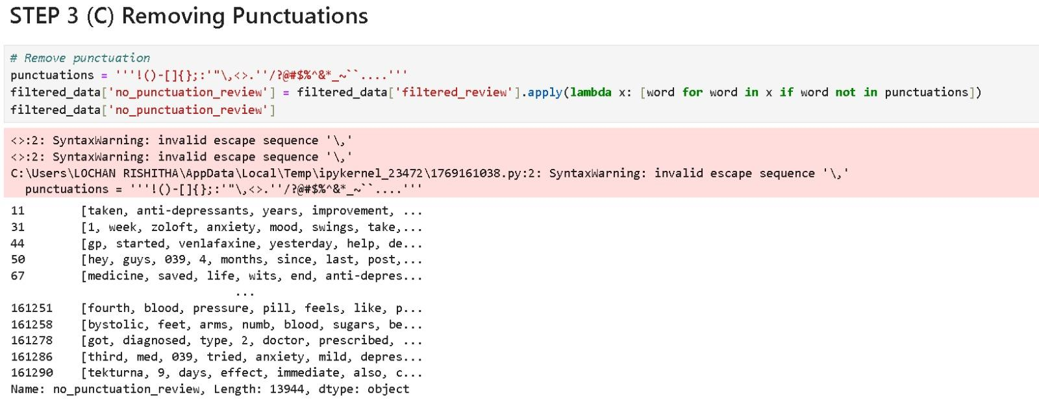

Slide 13
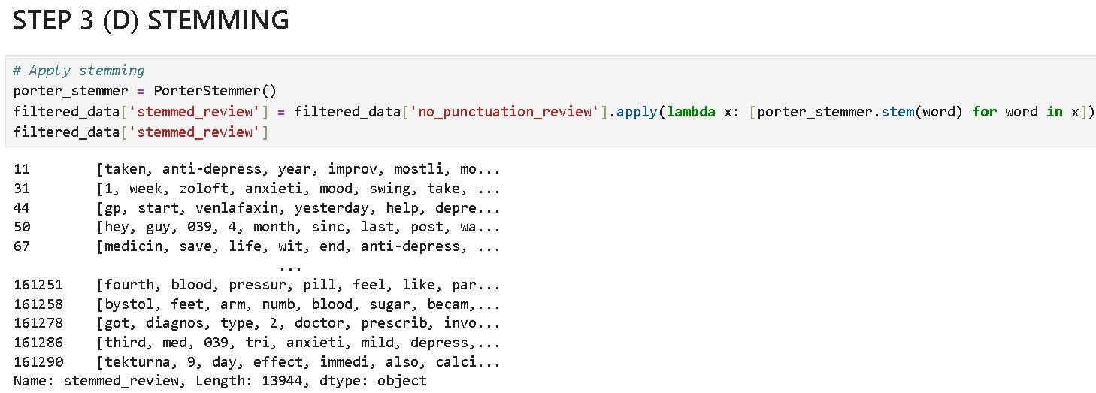

Slide 14

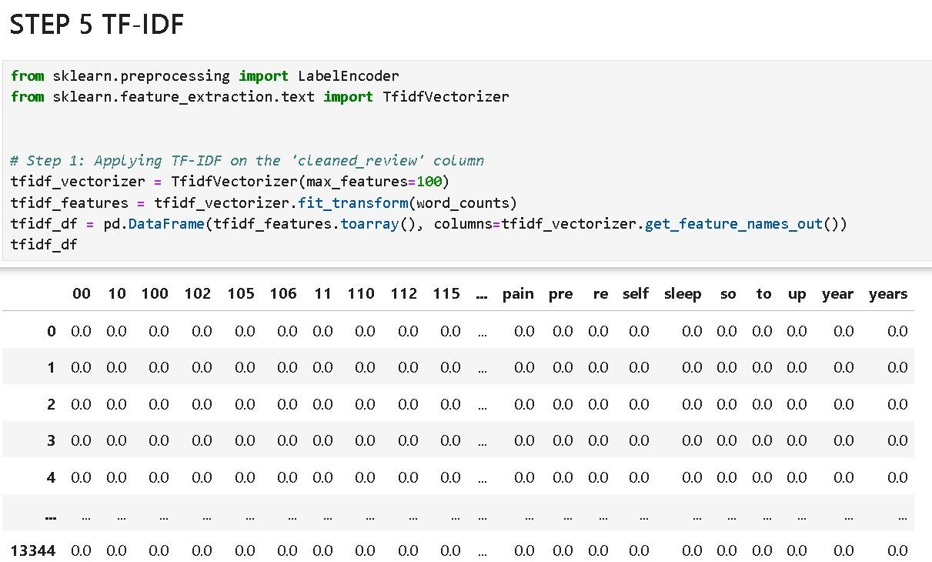

Slide 15
6. VISUALIZATION
Bigram (2-Gram)
Two consecutive words or tokens.
Trigram (3-Gram)
Three consecutive words or tokens.
N-Gram (General Case)
Extends to sequences of N words.
Word Cloud
A word cloud is a visual representation of the most frequently occurring words in a dataset, where word size indicates its frequency or importance.

Slide 16
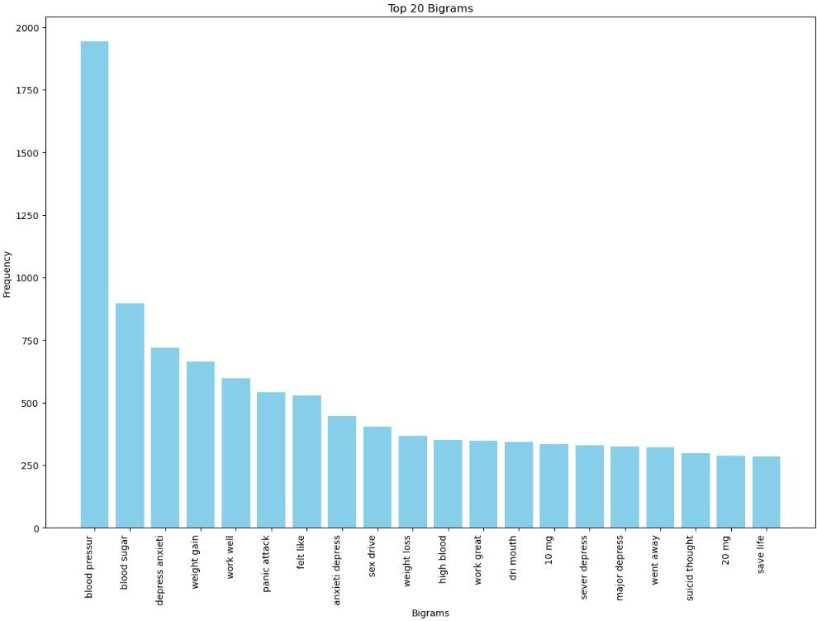

Slide 17
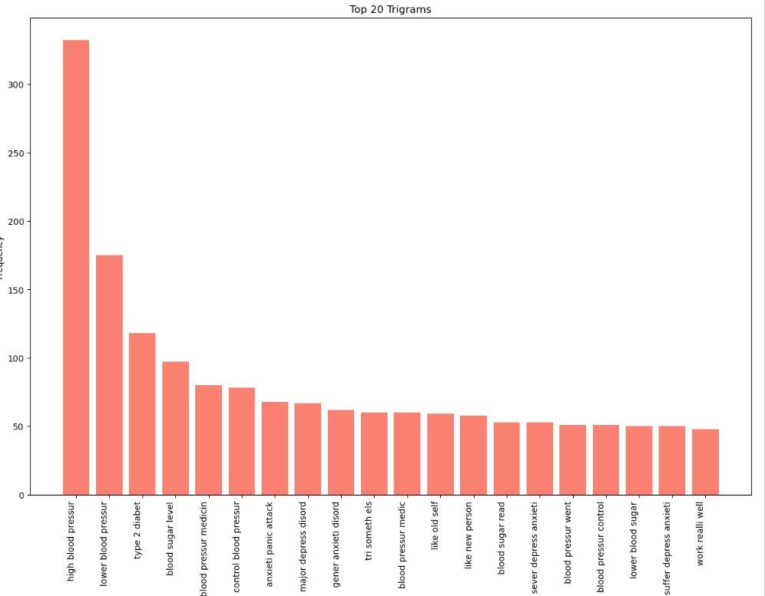
TRIGRAMS

Slide 18
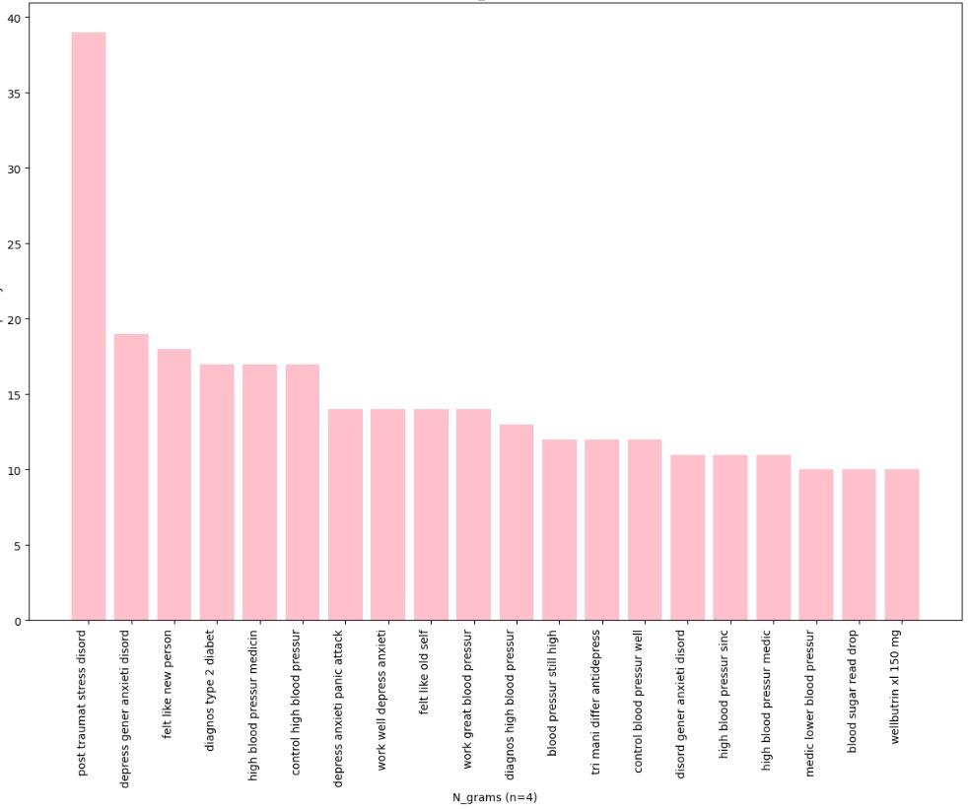

Slide 19
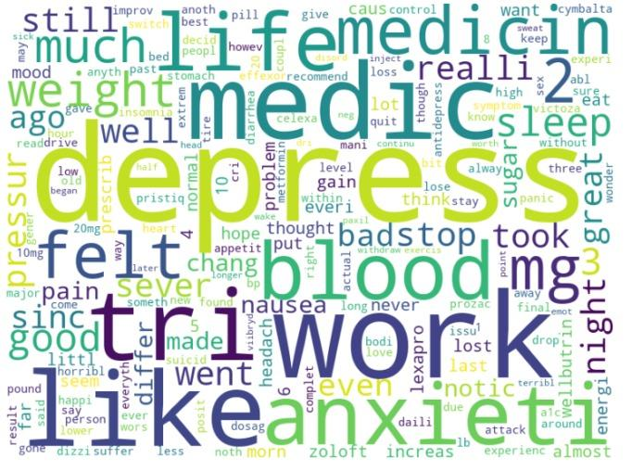
WORD CLOUD

Slide 20
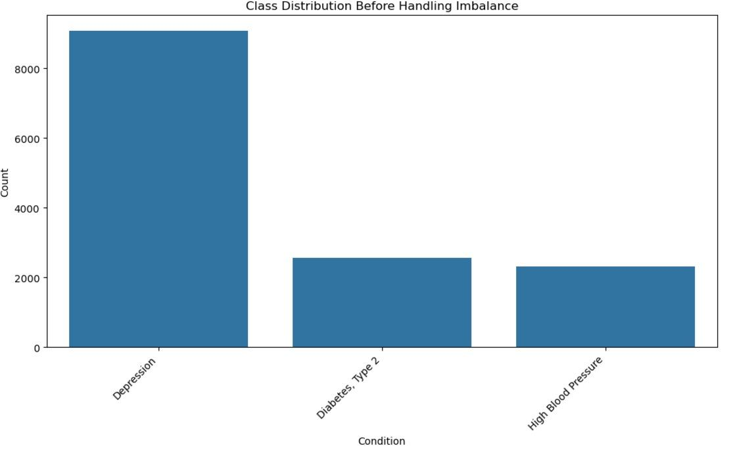
BEFORE PERFORMING SMOTE TECHNIQUE

Slide 21
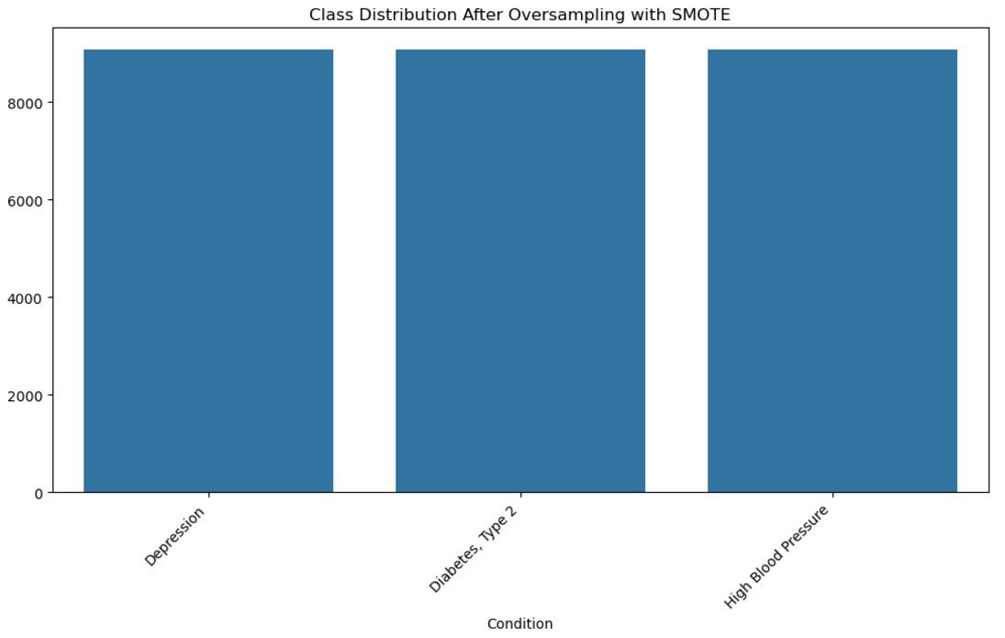
AFTER APPLYING SMOTE TECHNIQUE

Slide 22
7. MODEL BUILDING
Data Splitting
The dataset was divided into training and testing sets using Scikit-learn's train_test_split function.
This ensures that the model is trained on one portion of the data and tested on another to evaluate its generalization ability.
Inputs: X_resampled (features), y_resampled (target labels)
Proportions: 70% of the data used for training and 30% for testing.
Model Development was made by using various classification models, the best accuracy results were observed in Random Forest Model.
Model Evaluation:The model's performance was assessed using accuracy, a metric that measures the proportion of correctly predicted instances.

Slide 23
8. DEPLOYMENT
Deployment is the process by which ML model is moved from an offline environment and integrated into an existing production environment, such as a live application.
Using Streamlit our project is deployed.
Streamlit is a powerful open-source framework which is used to create interactive web apps for data science and machine learning projects.

Slide 24
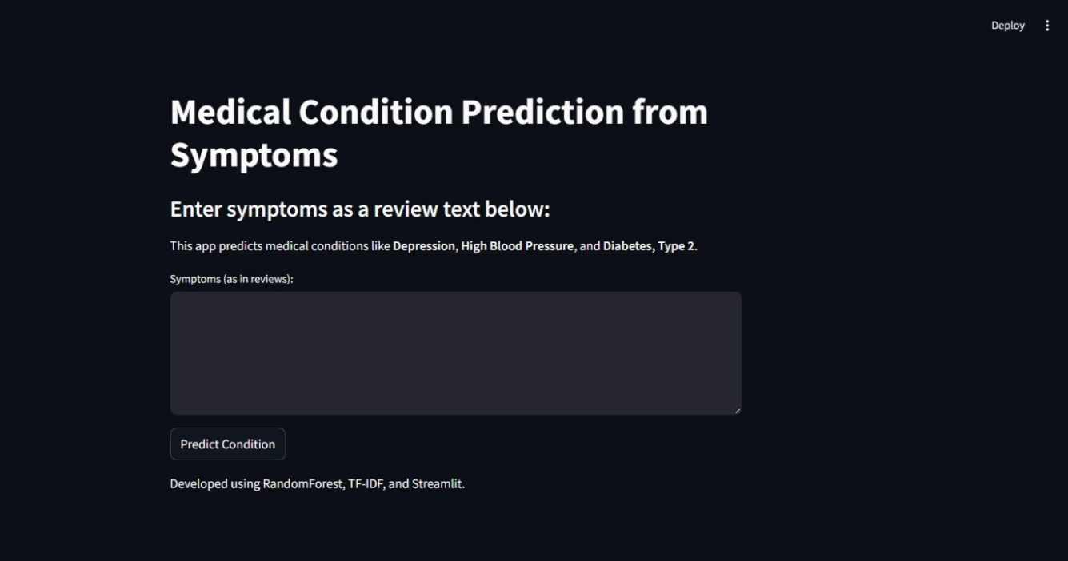

Slide 25
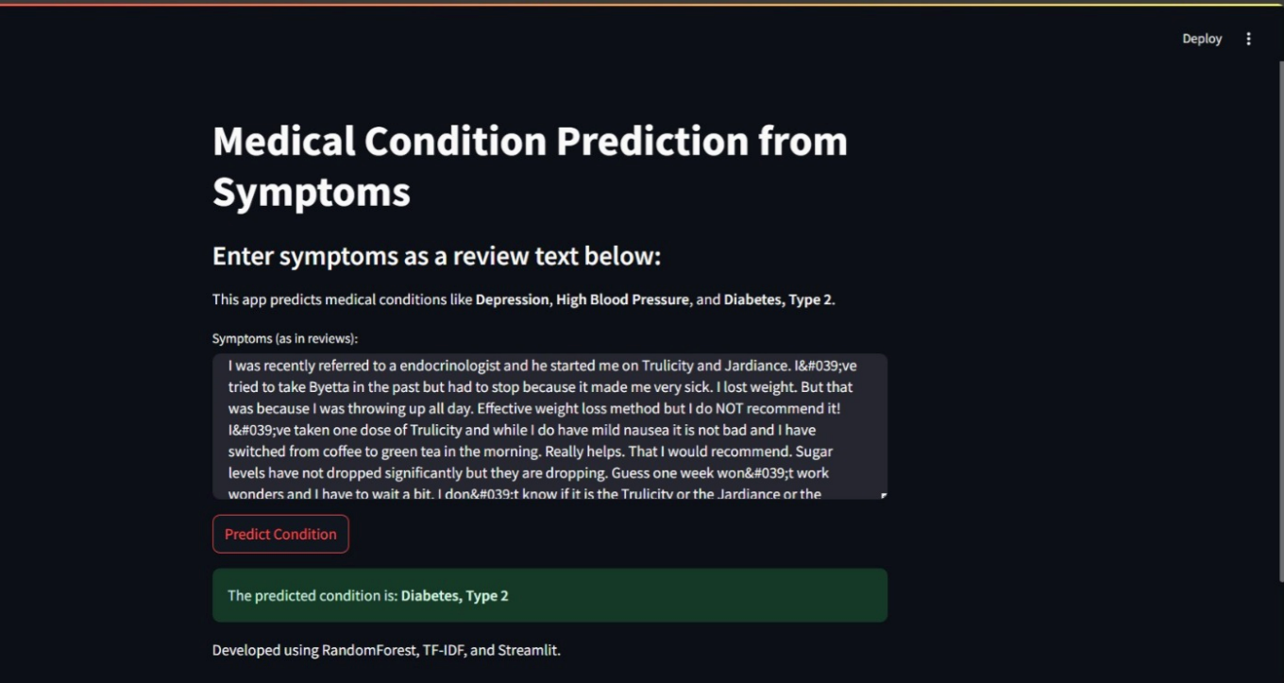

Slide 26
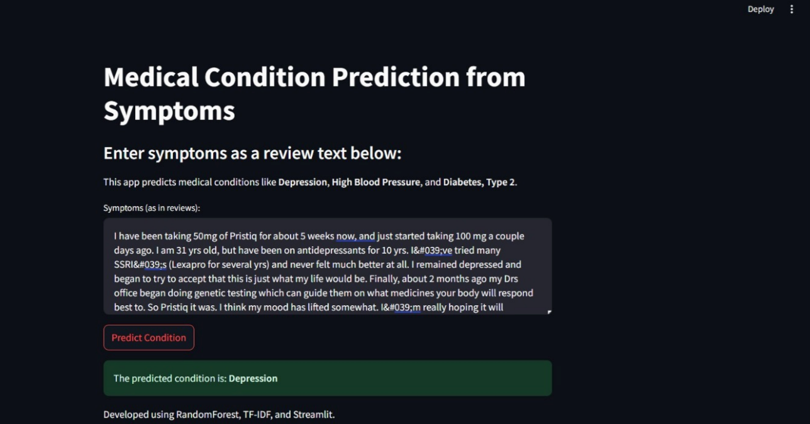
Depression Condition

Slide 27
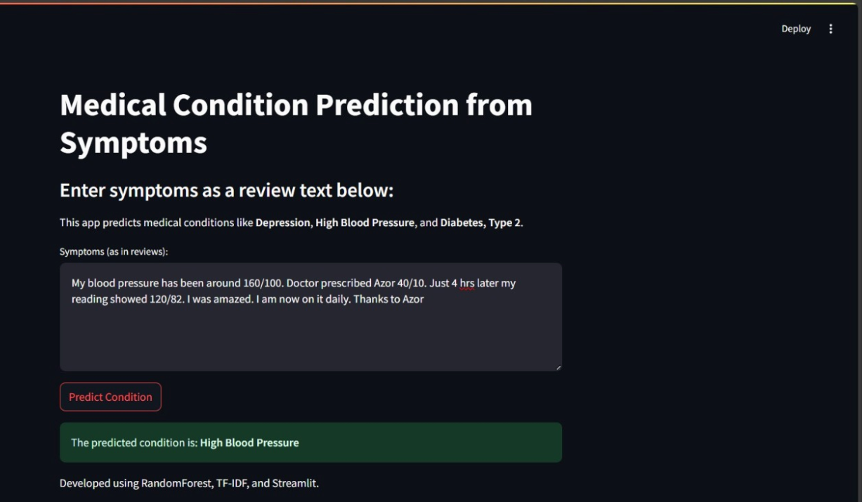
High Blood Pressure Condition checking

Slide 28
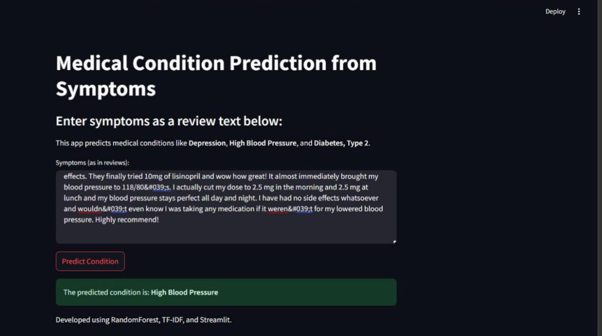

Slide 29
9. CHALLENGES
Imbalanced Data: Certain conditions like "Depression" dominate, which can bias predictions.
Text Complexity: Reviews may contain slang, typos, or context-dependent meanings.
Missing Values: The condition column has null entries that need handling.
High Dimensionality: After TF-IDF, the feature space is extensive.
Sentiment Analysis: Extracting sentiment from ambiguous text can be challenging.

Slide 30


